Slide 1



Weekly Progress: Embedding Results
On Development of an on-Premise AI Product Recommendation Model Using Open-Source LLM
Monir (248810)
02 April 2025
Department of Artificial Intelligence Convergence

Slide 2

Project Description
Project Title
Development of an on-Premise AI Product Recommendation Model Using Open-Source LLM
Company: Narosu Co. Ltd.
Project Description
The e-commerce market is becoming increasingly competitive, requiring advanced recommendation systems.
Large marketplaces use sophisticated AI models, but independent online store operators lack such solutions.
This project aims to develop an AI-powered product recommendation system tailored for self-managed online stores.
By analyzing customer preferences, the system will suggest products that align with their interests.
Project Objective
Develop an AI-based search and recommendation system that analyzes user input sentences and recommends the TOP 5 most relevant products based on semantic similarity.
Utilize Natural Language Processing (NLP) and vector search technology to provide a highly refined search experience.
Deploy in an on-premise environment to ensure data privacy and full control over the recommendation process.
1

Slide 3

Company Requirements
OpenAI text-embedding-ada-002 is a paid model
Try with free models such as:
Sentence Transformers (all-MiniLM-L6-v2)
Hugging Face E5-small Transformers (intfloat/e5-small-v2)
E5-multilingual-large: intfloat/multilingual-e5-large
LaBSE: sentence-transformers/LaBSE
2

Slide 4
Project Schedule (Gantt Chart)
Phase | 2025
 | March |  |  |  | April |  |  |  | May |  |  |  | June
 | 1 | 2 | 3 | 4 | 1 | 2 | 3 | 4 | 1 | 2 | 3 | 4 | 1 | 2
Project Understanding and Data Collection
Data Analysis and Pre-processing
Model Selection and Training
System Development
Chatbot UI Development
Testing and Deployment
3

Slide 5
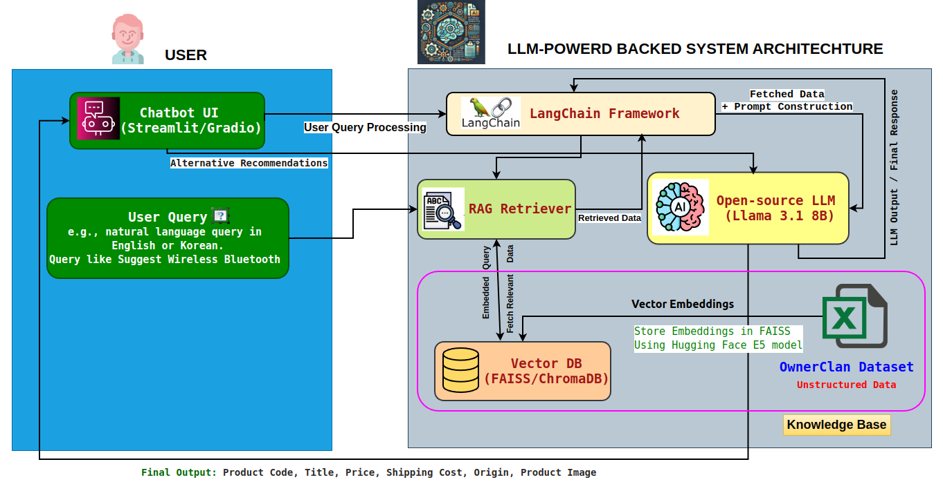
System Configuration (AI Model) Diagram
4

Slide 6
Communication with company
Questions:
Looking at the core technology stack you sent me, it uses FAISS as a vector search library, but is it okay to use something else?
Contents of the answer
In addition to FAISS (vector search library), you may use vectorDB or other vector search libraries.
5

Slide 7
Embeddings in our system (OwnerClan Dataset)
🔍 What are Embeddings?
Embeddings are numerical representations of text data.
Similar meanings produce similar vector representations.
Example: "블루투스 이어폰" and "Bluetooth earphone" → close in vector space.
📦 How Embeddings Work
Input: Product title + keywords + specs → combined text
Model: Free model generates vector embeddings
Storage: Vectors stored in FAISS (vector DB)
Search: User query → embedded → matched with product vectors
Product Info (Title + Keywords + Specs)
User Query (KR/EN)
Preprocessed into
Single Text
Query Embedding via E5 Model
Hugging Face E5 Model
(Generate Embeddings)
FAISS Similarity Search
Store Embeddings in
FAISS (Vector DB)
Top-K Matching Products
6

Slide 8
Example of Embeddings Output in our system
Original Query (KR): 게이밍 블루투스 헤드셋
Translated Query (EN): Gaming Bluetooth Headset
all-MiniLM-L6-v2 and intfloat/e5-small-v2
Result on Korean Dataset
원본상품명 키워드 카테고리명 Product Name (EN) Keywords (EN) Category (EN)
6953 맥스틸 올인원 게이밍 블루투스헤드셋,무선헤드셋, led헤드셋,올인원헤드셋,
헤드셋 GM-GHC300 헤드셋, 유선헤드셋,게이밍헤드셋 삼... 디지털/가전>멀티
미디어장비>PC헤드셋
Max Steel All-in-One Gaming Bluetooth headset, wireless headset Digital/Home Appliances>
Headset GM-GHC300 Headset Multimedia Equipment
Query output from this embedding sometimes provides incorrect results.
7

Slide 9
Embedding Process and Model Selection
Automatic language
detection
Process-1
User query
Korean/English/Japanese
Apply Translation
Returns results in
the Language(Ko/En/Jp)
of the query
Embedding data in
English using intfloat/e5-small-v2
Translated Dataset
Translation
OwnerClan
Korean Dataset
Embedding data in Korean
intfloat/multilingual-e5-large
Returns results in the
Language(Ko/En/Jp) of
the query
Automatic language
detection
Apply Translation
User query
Korean/English/Japanese
Process-2
8

Slide 10
Embedding with Process 1
🟢 Original Query: 패딩 크로스백
🔵 Translated to English: Padded cross bag (Lang Detected: ko)
9

Slide 11
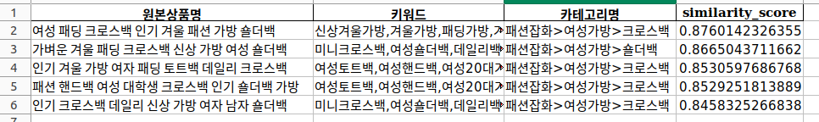
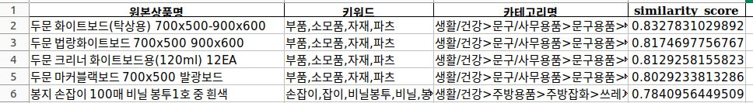
Embedding with Process 2
🟢 Original Query: 패딩 크로스백
🔵 Translated to English: Padded cross bag
🟢 Original Query: 화이트보드
🔵 Translated to English: White board
Sometimes provide incorrect results.
10

Slide 12
Next Tasks To Do
Next Step
Vector database performance selection based on response time and complex queries.
Compare the performance of different embedding models and select the best one.
11

Slide 13
Thank You for Listening
12

